Slide 1

Soccer Ball Experiment

Slide 2
Introduction
What we will do
Purpose
Measurements
Take apart soccer balls and investigate their properties
Understand how the different materials interact
Tension/compression, elasticity, slipperiness, and absorption

Slide 3
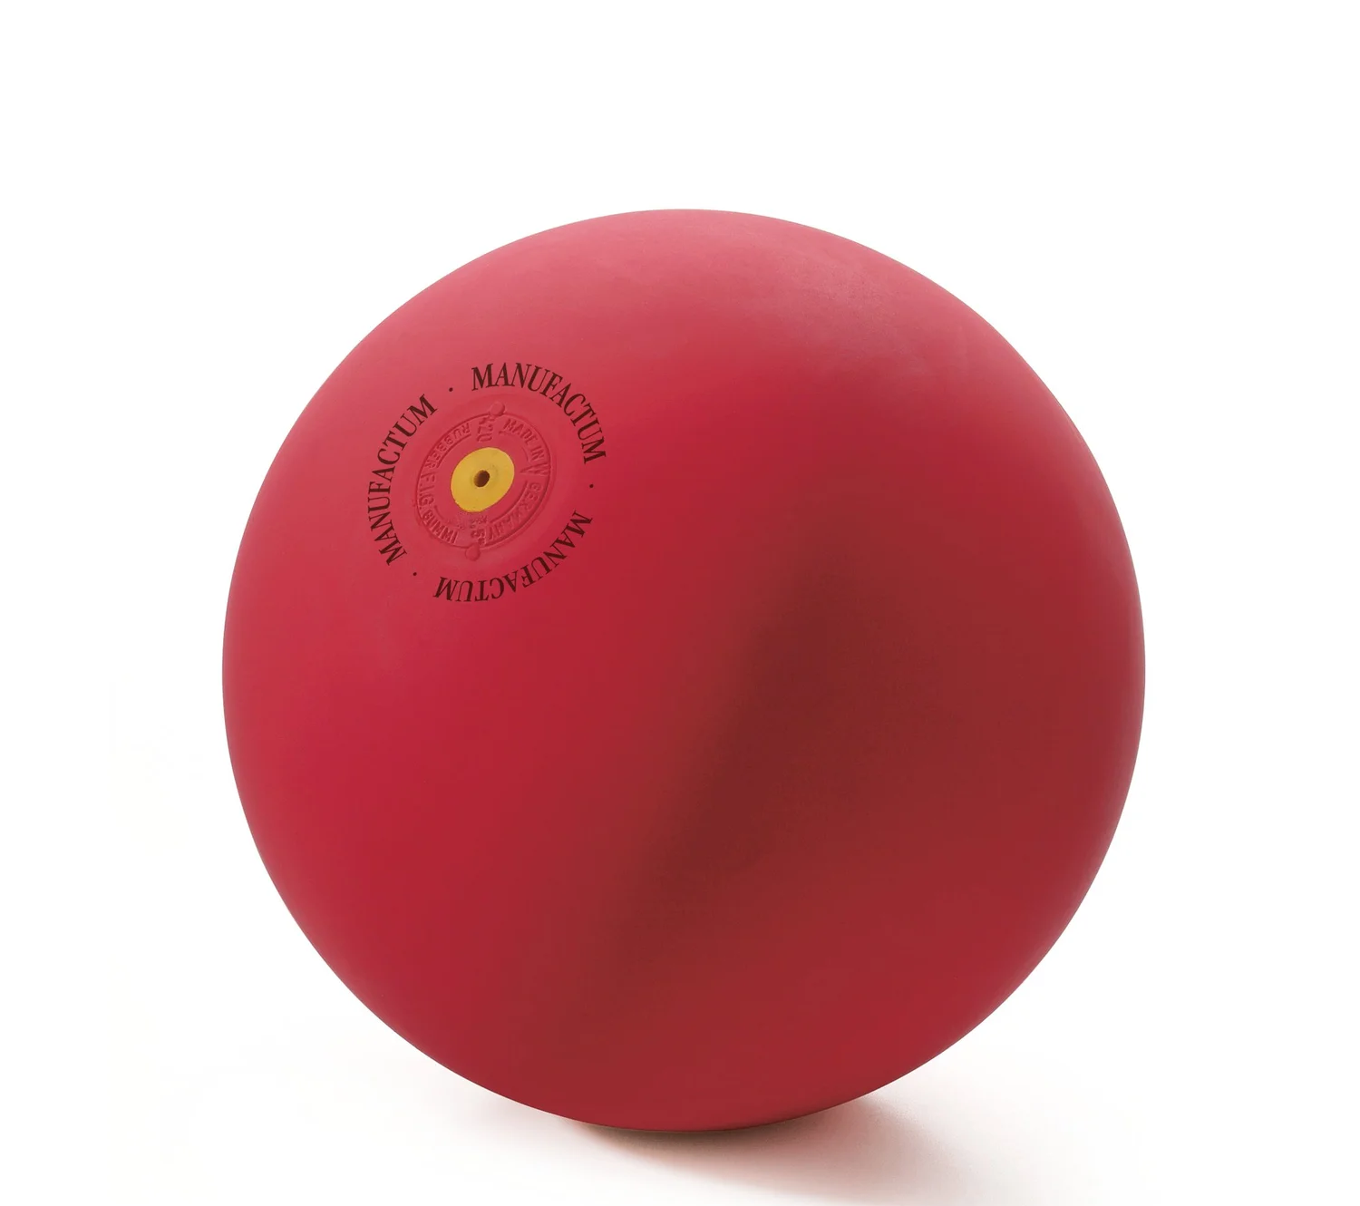
Juggling Competition Time
Pair up with a partner and listen up!

Slide 4
The Different Material Tests
How easily can you pull each layer apart?
Tension/ Compression
How do the layers respond when being pulled apart?
Elasticity
Slipperiness
How easily do the layers cause something to slip off of it?
Absorption
How well do the layers absorb water?

Slide 5
Discussion Questions to Keep in Mind
1. What was your methodology in cutting apart this soccer ball? What was easy about it, and what was difficult? Why do you think that is?
4. What did each material’s slipperiness allow us to conclude? What are some potential advantages and disadvantages of this, particularly in a soccer setting?
2. The outer layer in particular is made out of several materials. How many different materials did you end up identifying? What made them different?
5. Different materials absorb water differently. How does this factor into the order of materials in the ball, and how do the materials contribute to the ball’s function?
3. Some layers were easier to pull apart than others. What do you think contributed to why this is? Why could it be better to have some that are easier to pull apart?
6. Consider the soccer ball you dissected today. What do its material properties say about how well the ball can fare in different types of weather conditions and situations?

